Slide 1




Policy Utilization Report
1st October 2020 –Feb 9 2021
Dallah Group

Slide 2

TOPIC
3
4
7
10
11
Dallah Group Overview Top 50 Claimants - Amount wise
Top 50 Claimants - No. of Claims per Member
Summary of Benefit utilization
Top Providers - Claims Amount wise

Slide 3
Dallah Group Overview

Slide 4

Top 50 Claimants - Amount wise

Slide 5
Top 50 Claimants - Amount wise

Slide 6
Top 50 Claimants - Amount wise

Slide 7
No. of Claims per Member - Top 50 Claimants

Slide 8
No. of Claims per Member - Top 50 Claimants

Slide 9
No. of Claims per Member - Top 50 Claimants

Slide 10

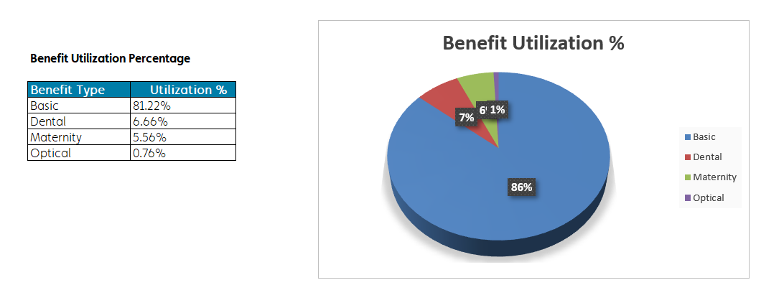
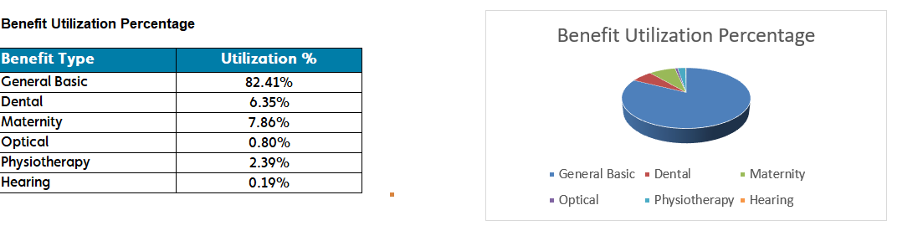
Summary of Benefit utilization
From: 01-Oct-2020 To: 09-feb-2020
Page 1 of 1
V.01
23-JUL-2019 03:25 PM

Slide 11
Top Providers - Claims Amount wise
From: 01-Oct-2020 To: 09-feb-2021
V.07

Slide 12
Top Providers - Claims Amount wise
From: 01-Oct-2020 To: 09-feb-2021
V.07

Slide 13
Top Providers - Claims Amount wise
From: 01-Oct-2020 To: 09-feb-2021

Slide 14

THANK YOU

